Slide 1

COMMUNICATION

Slide 2
Human Communication
Verbal
Intrapersonal Interpersonal Mass Media Business Communication
Formal Informal
Vertical Horizontal Consensus
Grapevine
Downward Upward
Non Verbal
Kinesics
Occulesis
Paralanguage
Proxemics
Artifacts
Chronemics
Tactilics

Slide 3
Definition
The word “communication” is derived from a Latin word “communis” which means “to share”.
For a layman communication is to exchange information.
For a professional communication is the transmission of information, ideas, emotions, skills through the use of symbols, words, figures and graphs.
The process of transformation is called communication.
Communication is a two-way process.

Slide 4
ELEMENTS OF COMMUNICATION
Sender – Here, the sender conceptualizes the idea or the conversation he wants to convey it to the recipient.
Encoding – Now the sender starts the encoding process where he utilizes words or non-verbal means to translate the thought into a message.
Message – After encoding, the sender receives the message that he wants to send.
Communication Channel – The sender then decides through which medium or channel he/she wants to send the message to the recipient. They must choose the channel to have an effective and correct interpretation of a message to the recipient.
Receiver – The receiver receives the message and tries to comprehend in the best possible way.
Decoding – In this step, the receiver translates the sender’s information and tries to perceive it most suitably.

Slide 5
Feedback – It is the last step of the communication process that assures the recipient, has received the information and understood correctly as the sender designed it.
Communication Process
Encodes Decodes
Feedback
Sender
Channel
Receiver

Slide 6
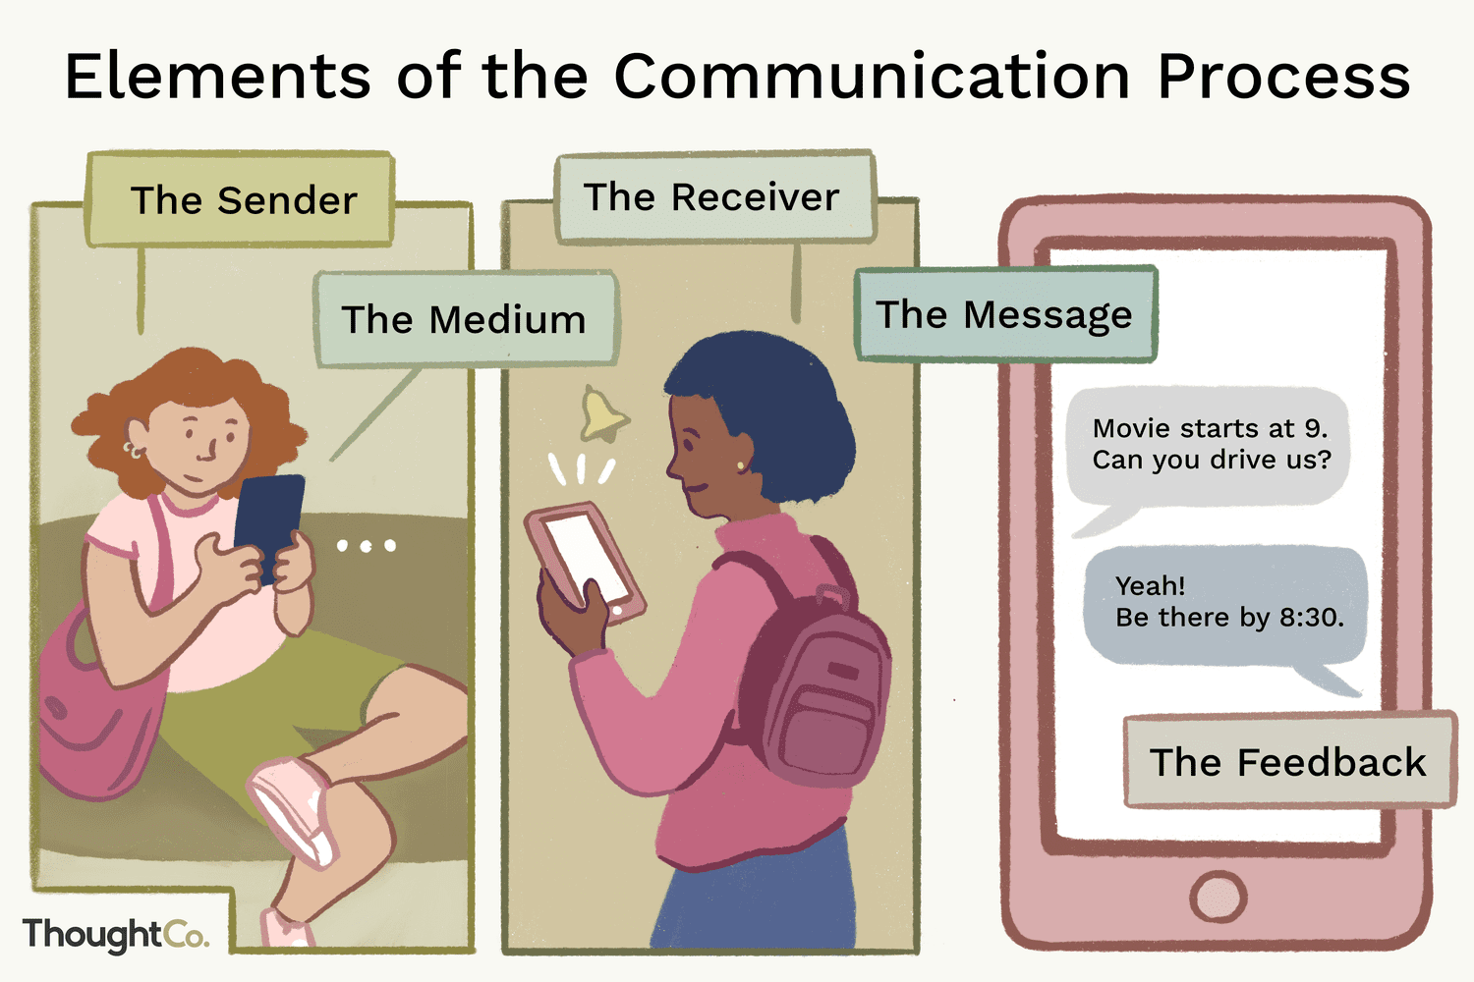

Slide 7
Requirements of communication when sender & receiver have common background, common frame of reference and right register then communication is successful.
Noise in communication
Physical noise refers to disturbance
Semantic noise when grammar or different meaning is given to a word whereas receivers take other meaning or use of jargon.

Slide 8
Need for communication is a business organization is external as well as internal.
Internal Need
Business has grown in size: The branch offices need to coordinate with the central head office to know about the activities of the branches.
Business has coordinate with all internal departments like sales, purchase production to know what is happening. Like production department should know about sales and make the goods accordingly.

Slide 9
External Need
Business houses have to deal with income tax, transport, import-export houses so there is an external need for communication.
Communication has become job requirement.
Communication is life line of any organization.
The Head of departments need to address mass media and other people about their business transactions.

Slide 10
MEDIA OF COMMUNICATION
Written Oral Visual Audio-Visual Computer-based

Slide 11
WRITTEN COMMUNICATION
Includes letters, circulars, memos, telegrams, reports, minutes, forms and questionnaires, manuals, etc.
Everything that has to be written and transmitted in the written form falls in the area of written communication.

Slide 12
WRITTEN COMMUNICATION
Merits:
It is accurate and precise. Written communication allows for careful choice of words, structure, and organization, promoting clarity and precision in conveying complex information.
It can be repeatedly referred to.
It is a permanent record.
It is a legal document. Written messages create a lasting record that can be referred to in the future. This is valuable for legal or formal purposes and helps avoid misunderstandings.
It facilitates the assignation of responsibilities
It has a wide access. Written communication can be accessed at any time, providing flexibility for individuals to review, analyze, and respond based on their schedule.

Slide 13
WRITTEN COMMUNICATION
Limitations:
It is time-consuming. Composing written messages, especially lengthy ones, can be time-consuming
It is costly. Printing materials, distributing documents, and managing physical or digital storage can incur costs
Quick clarification is not possible. Unlike verbal communication where immediate clarification can be sought, written communication may lack the real-time interaction needed for instant clarification of doubts or questions.

Slide 14
ORAL COMMUNICATION
Includes face-to-face conversation, conversation over telephone, radio broadcasts, interviews, group discussions, meetings, conferences and seminars, announcements over the public address system, speeches, etc.

Slide 15
ORAL COMMUNICATION
Merits:
Oral communication saves time.
Oral communication saves money also.
Speech is a more powerful means of persuasion and control.
The speaker can convey shades of meaning.

Slide 16
ORAL COMMUNICATION
Merits:
The speaker can get immediate feedback.
Employees get an opportunity for feedback and clarification.
The informal place helps to promote friendly relations.
Oral communication is useful while communicating with groups.

Slide 17
ORAL COMMUNICATION
Limitations:
It is not possible if the communicator and the receiver are far removed.
Lengthy messages are not suitable for oral transmission.
Oral messages cannot be retained for a long time.
Oral messages do not have any legal validity unless taped or made part of permanent record.
There is a greater chance of misunderstanding.
Responsibilities for mistakes cannot be specifically assigned.

Slide 18
ORAL COMMUNICATION
Essentials of oral communication:
Clear pronunciation.
Brevity.
Precision.
Conviction.

Slide 19
ORAL COMMUNICATION
Logical sequence.
Appropriate word choice.
Avoiding hackneyed phrases and cliches.
Natural voice.
Finding the right register.

Slide 20
FACE TO FACE COMMUNICATION
Merits:
Facial expressions and gestures help to communicate better.
Particularly suitable for discussion.
Demerits:
Difficult to practise in large-sized organizations.
Not effective in large gatherings.
Ineffective if the listener is not attentive.

Slide 21
VISUAL COMMUNICATION
Encompasses gestures and facial expressions, tables and charts, graphs, diagrams, posters, slides, film strips, etc.
Mime is an old art in which ideas and emotions are communicated through facial expressions and gestures. Example: two pieces of bone put in a cross-wise fashion with a skull placed in between and they signify danger.
Communication through such visuals is very effective because it is sure and instantaneous. No words are uttered, no signs made, and yet the message gets across.
Visual communication can be used to transmit very elementary and simple ideas, orders, warnings. It can be effectively used only in combination with other media.

Slide 22
AUDIO-VISUAL COMMUNICATION
Encompasses television and cinema films that combine the visual impact with narration.
A combination of sight and sound – may make use of the written word also.
Visual communication is not found to be adequate in itself. People will just casually glance at it and let it go at that. It is quite likely that they will miss the message. But if the slides are accompanied with explanation and narration, it will facilitate interpretation and ensure that the message is driven home. Besides, information transmitted through audio-visual means is retained much longer than through any other means. It is a matter of common experience that people can easily recall some of the powerfully depicted scenes of a movie years after they have seen it.

Slide 23
AUDIO-VISUAL COMMUNICATION
Audio-visual communication is found most suitable for mass publicity, mass propaganda and mass education. Large business houses frequently make use of this technique to educate their workers and to popularise their products. The working of a new household appliance like a mixer or a washing machine, the effectiveness of a new detergent powder, the freshness of new designs in suiting's and shirting's can be effectively demonstrated through audio-visual means. Within the organisation, the workers can be educated by suitable demonstrations on the close-circuit television screen.
To use this technique effectively, it is necessary to make the films and slides attractive and interesting, and the narration clear, precise, lucid and easily understandable. It is also advisable to keep the films short and to screen them at an appropriate time.

Slide 24
COMPUTER-BASED COMMUNICATION
Computer technology has dramatically changed the landscape of business communication today. It is fast annihilating the barriers of time and space and the concept of our world turning into a small global village now appears to be a distinct and near possibility. For it is not possible to communicate instantaneously with people inhabiting the remotest places possible.
In earlier times, the manager dictated a letter to his secretary. When the secretary brought it typed, he reviewed it, revised it and got it retyped. In all probability he again made a few modifications and got the final draft typed. The envelope was typed too. The letter was dropped in the mail and was delivered at the destination several years later. The whole process was quite cumbersome and time-consuming.

Slide 25
COMPUTER-BASED COMMUNICATION
For example, if two persons have the facility of two computer terminals connected on network. One of them types a message on his computer. S/he can edit it, alter it, or reword it as many times as s/he likes without wasting any time. When s/he is fully satisfied, s/he just presses a button and the message is immediately transmitted to its destination. At the other end, the receiver can open the mail, read the message on the monitor and immediately respond to it, or attend to it at their leisure. The whole process takes hardly more than a few minutes.
Fax, voice mail, E-mail (electronic mail), cellular phones, telephone answering machines, video conferencing, etc., are some of the computer-based media of communication

Slide 26
COMPUTER-BASED COMMUNICATION
Advantages of computer technology:
The quickest means of communication.
Space no longer a barrier to communication.
Video conferencing can replace personal meetings.
World-wide web as a publishing platform.

Slide 27
COMPUTER-BASED COMMUNICATION
Advantages of computer technology:
Better means of keeping permanent record of valuable and bulky data.
This sort of storage has four distinct advantages:
Easy to store;
Equally easy to retrieve;
Since it is stored in a compressed format, it is possible to store even bulky data.
If the computer is networked, this information can be shared and accessed by a large community of people.

Slide 28
COMPUTER-BASED COMMUNICATION
Limitations:
Uncertain legal validity.
Fear of undesirable leakage.
The virus malady.

Slide 29
SILENCE
We do not communicate through words, signs and signals alone, we communicate through silence also. ‘Silence is more eloquent than words’ is not a meaningless adage. It is not unusual to come across a situation in which nothing can express one’s response so effectively as silence. Silence can effectively communicate a number of responses.
Silence may signify communication gap, respect, fear, refusal, disapproval, anger, resentment and/or lack of interest.

Slide 30
SILENCE
The most effective use of silence can be made by giving a slight pause before or after making an important point during a speech. This is what the most successful orators usually do. A slight pause before an important talk creates suspense; it raises a sense of anticipation and the audience listens to the next point more attentively. And a slight pause afterwards suggests that something very important has been said and the speaker desires his audience to assimilate it and realize its significance before he passes on to the next point.

